Slide 1

Staying Safe Online
Dealing with communication online

Slide 2
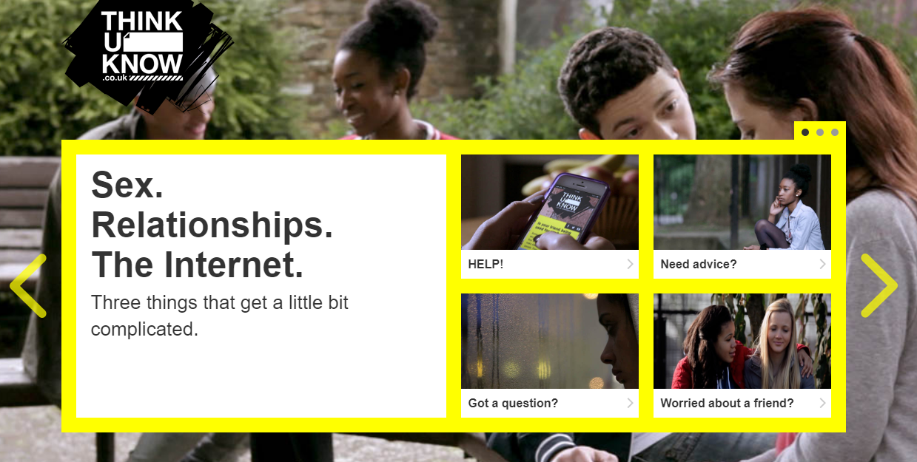
Thinkyouknow.co.uk
If you worried about your own or a friends internet behaviour please use the website for support.

Slide 3
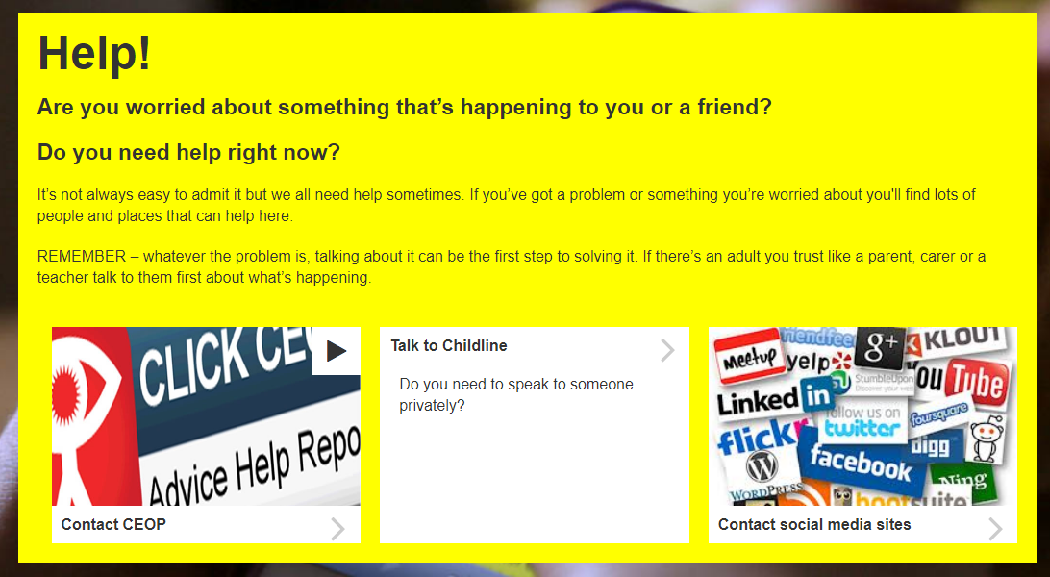
CEOP is the think you know website where you can report online abuse
You can contact Childline online or by calling 0800 1111
Remember you can block and report unwanted communication through Social Media platforms

Slide 4
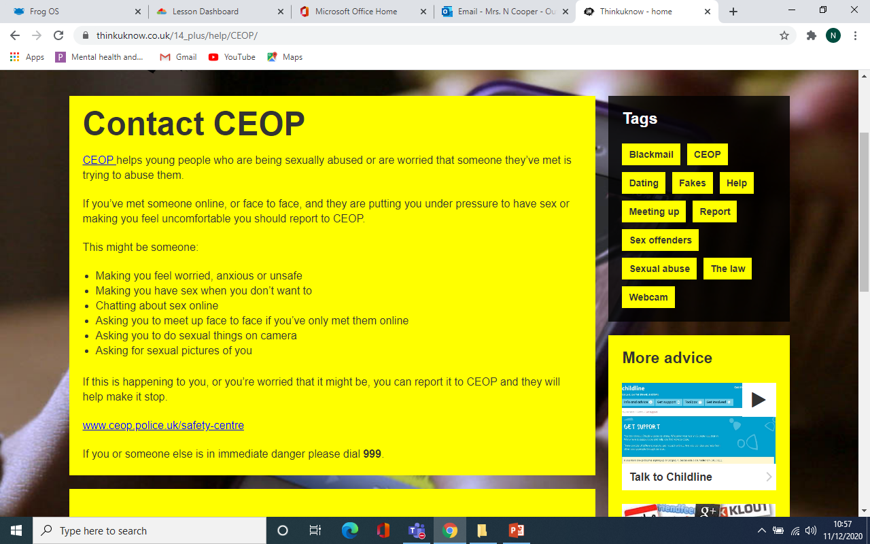

Slide 5
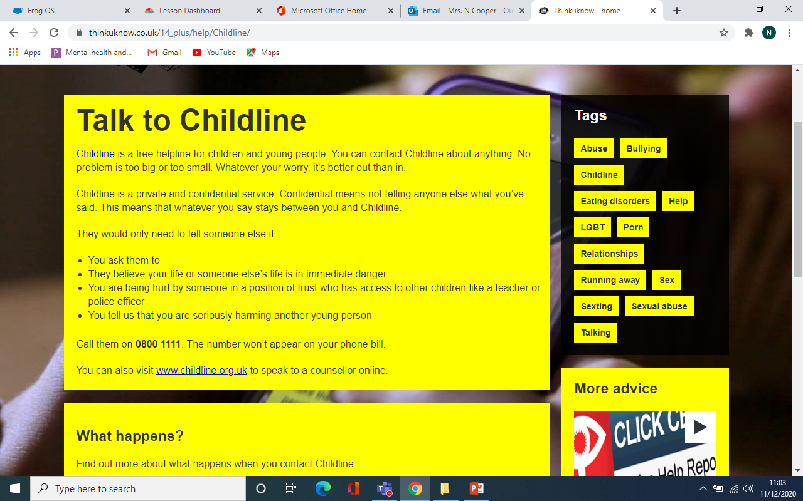
Call: 0800 11 11

Slide 6
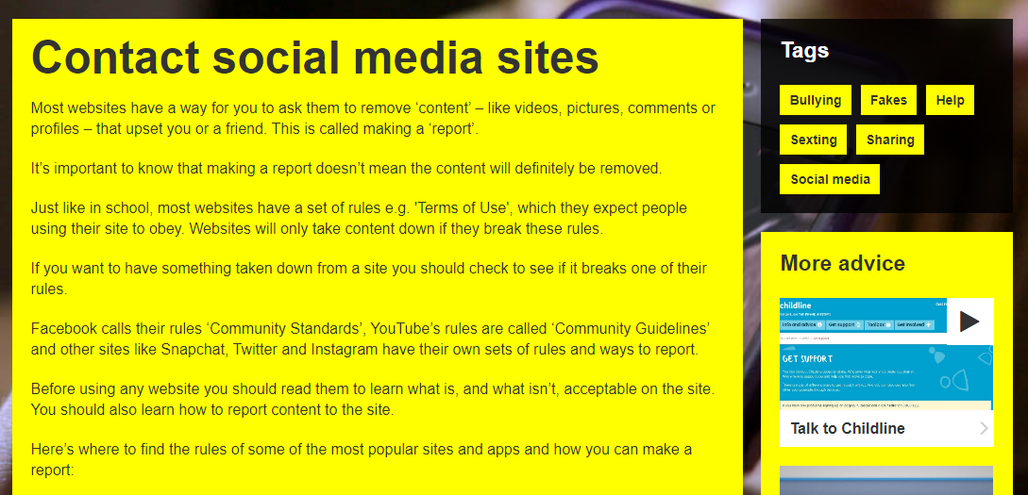
For a direct link to report on the Social Media platforms go the following address:
https://www.thinkuknow.co.uk/14_plus/help/Contact-social-sites/

